Slide 1
Future Design Workshop
Future Design Workshop
(Your Name Here)

Slide 2
Table of Contents
01. Opening Remarks
02. What is Future Design?
03. Group Formation
04. Past Design Discussion
05. Future Design Discussion
06. Summary of Discussion Results
07. Presentation

Slide 3
01. Opening Remarks

Slide 4
02. What is Future Design?

Slide 5
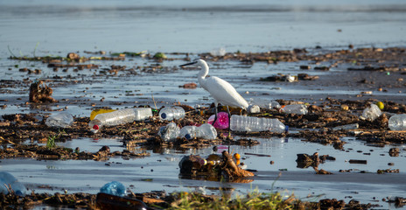
02. What is Future Design?
Various issues have emerged those threaten sustainability.
In the field of environmental studies, climate change, biodiversity loss, and air, water, and soil pollution are typical examples.¹⁾
Many people aiming to resolve these issues likely feel frustration and impatience at the slow progress.

Slide 6
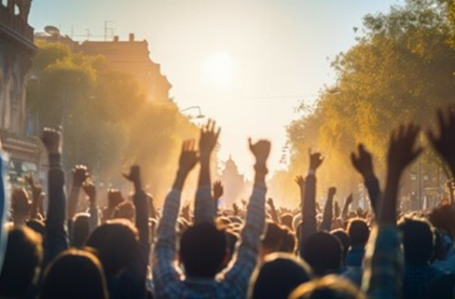
02. What is Future Design?
Two main mechanisms
that govern the modern society:
Why is it so difficult to resolve these issues?
Market: the system through which modern people exchange goods.
Democracy: the system through which modern people express their will.
Because future generations cannot participate in the present mechanisms governing the modern society.
We call the resulting failures as “future failures“.²⁾

Slide 7
02. What is Future Design?
How can we avoid these failures?
It may be necessary to change people's behavior through regulation and penalties. ³⁾
However, before that, why not aim for the realization of a society where people's inherent futurability* is naturally manifested? ²⁾
One powerful approach is to adopt the perspective of imaginary future people and creatively design societal mechanisms.⁴⁾
*
The trait of feeling joy in acting for the benefit of future generations

Slide 8
02. What is Future Design?
We define Future Design (FD) as the practice of envisioning the future by stimulating our present consciousness to represent the voices of future generations and facilitating the transition of society towards that future.
Definition
If we engage in this practice now, people in the future, decades from now, might look back on us with gratitude.

Slide 9
03. Group Formation

Slide 10
03. Group Formation
Please form pairs with
the person sitting next to you.
If someone cannot find
a partner, it is also fine to form a group of three.

Slide 11
04. Past Design Discussion

Slide 12
04. Past Design Discussion
What is Past Design? ⁵⁾
Definition: To speculate on how the decisions of past generations have shaped today's society and to hypothetically design how today's society might differ if alternative decisions had been made.
Objective 1:
To realize that we are the future people from the perspective of past generations.
Objective 2:
To cultivate the desire to become good ancestors.⁶⁾
Objective 3:
To practice smoothly transitioning into the role of imaginary future people.
Now, let's actually experience Past Design!

Slide 13
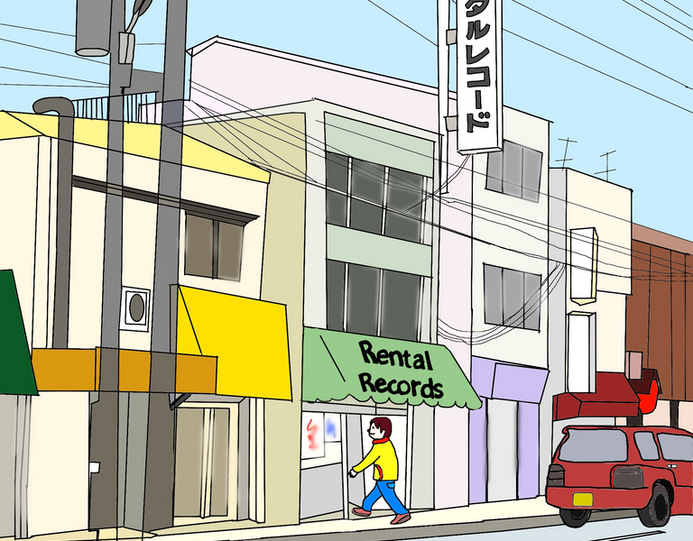
04. Past Design Discussion
Late 1970s
1980
Mid-1980s
Radio cassette players with record players, which allowed recording records onto cassettes at home, became popular.
Rental record shops appeared, making it possible to rent records and record them onto cassettes at home.
The rental record issue ⁷⁾ , a conflict between record shops (and the music industry) and rental record shops, surfaced.

Slide 14
04. Past Design Discussion
Rental Record Shops
Record Shops
We ensure that the royalties we pay are properly given to the creators of
the music.
Since 1984,
we have been paying 10% of our
rental sales as
royalties.
If a 3000-yen record is rented for 300 yen, records won't sell.
If a 3000-yen record is rented for 300 yen,
records won’t sell.
Are you saying
that from now on, the number of rentals, not sales, will be the measure of a hit?
We are the ones contributing to the prosperity of music culture.
We provide young people with opportunities to access music at an affordable price.
If there are no music creators, music culture will decline.

Slide 15
04. Past Design Discussion
１
２
As of 2024, what would you like to tell people in the past about the current situation?
What messages would you like to send to them?
It would be beneficial to keep the following message types in mind:
Type 1: Gratitude (Thank you for doing …!)
Type 2: Regret (Why did you do … ? Why didn't you do …?)
Type 3: Indifference (That issue is no longer relevant today!)
For Type 2, consider things where you think, "Even accounting for the unpredictability of the future, I wish people had tried harder back then."

Slide 16
05. Future Design Discussion

Slide 17
05. Future Design Discussion
１
２
To make such a 2054 a reality, please send your requests to the people of 2054.
The recipients of your request are the people who gathered for the [insert event name] in 2024 to [insert the event purpose].
As of 2054, what does the world look like, and how are you seeking happiness in it?
©2024 Nakagawa & Saijo

Slide 18
05. Future Design Discussion
Important Request (1)
We would like everyone to enjoy fireside chat as imaginary future people. This is not a formal discussion where you need to take notes.
Important Request (2)
Since you are living in 2054, you must speak about 2024 in the past tense.
(Wrong) Now, the use of generative AI is rapidly spreading.
(Correct) At that time, the use of generative AI was rapidly spreading.

Slide 19
06. Summary of Discussion Results

Slide 20
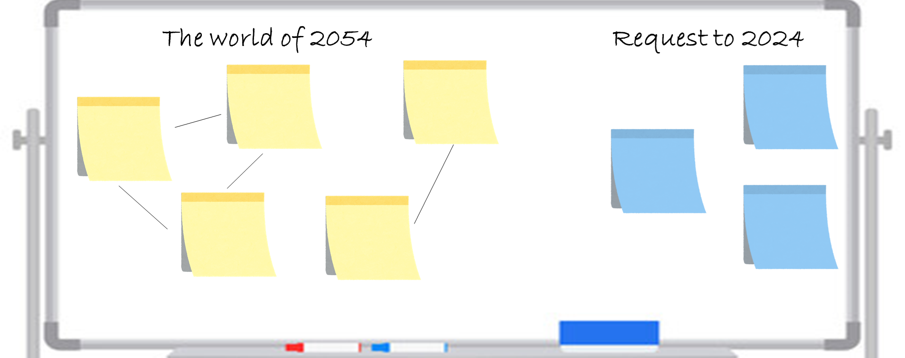
06. Summary of Discussion Results
1
Please write down the ideas for (1) (about the world in 2054) on yellow sticky notes.
2
Please write down the ideas for (2) (requests for 2024) on blue sticky notes.

Slide 21
07. Presentation

Slide 22
07. Presentation
Please present the results of your group discussion within one minute.

Slide 23
Finally...
As a future person, you have demonstrated creativity and conceived a message directed towards you as a contemporary individual.
As a contemporary individual who receives a message conceived by none other than yourself, you will find yourself unable to refrain from reconsidering your thoughts and actions for the future.
In this way, the “futurability” you possessed naturally manifest themselves.
Thank you!

Slide 24
Notes
For example, Richardson, K., Steffen, W., Lucht, W., et al. (2023). Earth beyond six of nine planetary boundaries. Science Advances, 9, eadh2458.
For a paper positioning the market and democracy as causes of future failure and defining future possibilities, see: Saijo, T. (2020). Future design: Bequeathing sustainable natural environments and sustainable societies to future generations. Sustainability, 12(16), 6467.
For a comparison between methods of social science interventions in actions towards others and Future Design (FD), see: Pandit, A., Nakagawa, Y., Timilsina, R. R., Kotani, K., & Saijo, T. (2021). Taking the perspectives of future generations as an effective method for achieving sustainable waste management. Sustainable Production and Consumption, 27, 1526-1536.
The concept of imaginary future people was first proposed in the following paper: Kamijo, Y., Komiya, A., Mifune, N., & Saijo, T. (2017). Negotiating with the future: Incorporating imaginary future generations into negotiations. Sustainability science, 12, 409-420.
The idea of Past Design was first proposed in the following paper: Nakagawa, Y., Kotani, K., Matsumoto, M., & Saijo, T. (2019). Intergenerational retrospective viewpoints and individual policy preferences for future: A deliberative experiment for forest management. Futures, 105, 40-53.
For the use of the concept of "Good Ancestor," the following book was referenced: Krznaric, R. (2020). The good ancestor: How to think long term in a short-term world. Random House.
Regarding the issue of rental records, the information was based on the following references: Hiroyuki Oba. (2020). Lending rights and rental prohibition periods in rental records. Journal of Education, 56, 1-16. Asahi Shimbun "Voice" March 22, 1987, April 1.

